Slide 1
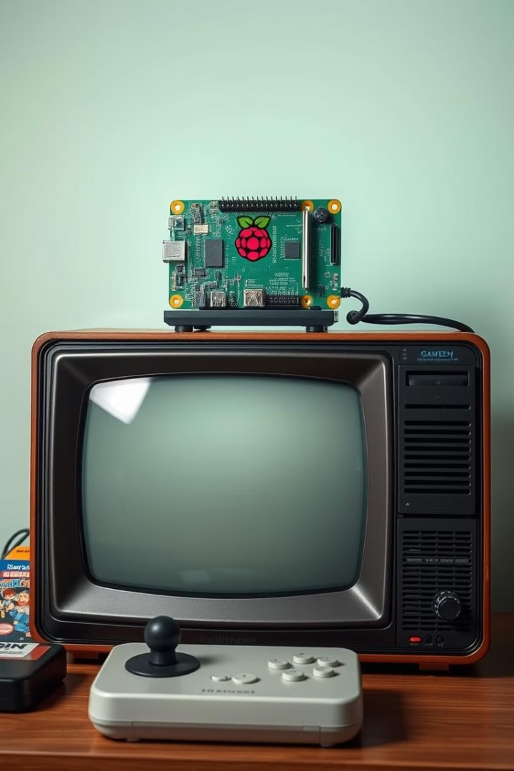
RetroPie: Bringing Retro Gaming to Life
RetroPie is a remarkable open-source project that breathes new life into classic gaming experiences. It allows users to transform their Raspberry Pi, ODroid C1/C2, or even PCs into powerful retro gaming consoles, enabling them to play a vast library of beloved arcade, home console, and classic PC games. This presentation will delve into the motivations, objectives, working principles, and results of this incredible project, showcasing its unique design and capabilities.

Slide 2
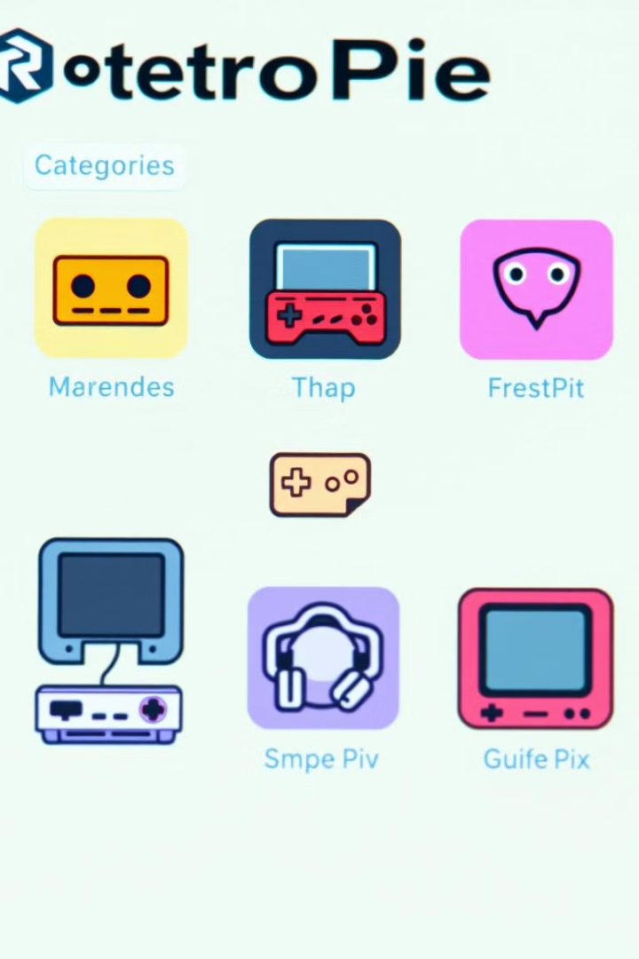
Overview
Open-Source Software
Emulation
RetroPie is built upon a foundation of open-source software, enabling developers to contribute to its growth and fostering a collaborative community.
At its core, RetroPie is an emulation platform, capable of recreating the hardware and software of various retro gaming systems.
Raspberry Pi
Extensive Game Library
While primarily designed for Raspberry Pi devices, RetroPie can also be installed on other platforms, including ODroid C1/C2 and PCs.
RetroPie supports a wide array of classic games, covering arcade machines, home consoles, and early PCs, offering a vast library for gamers to explore.

Slide 3
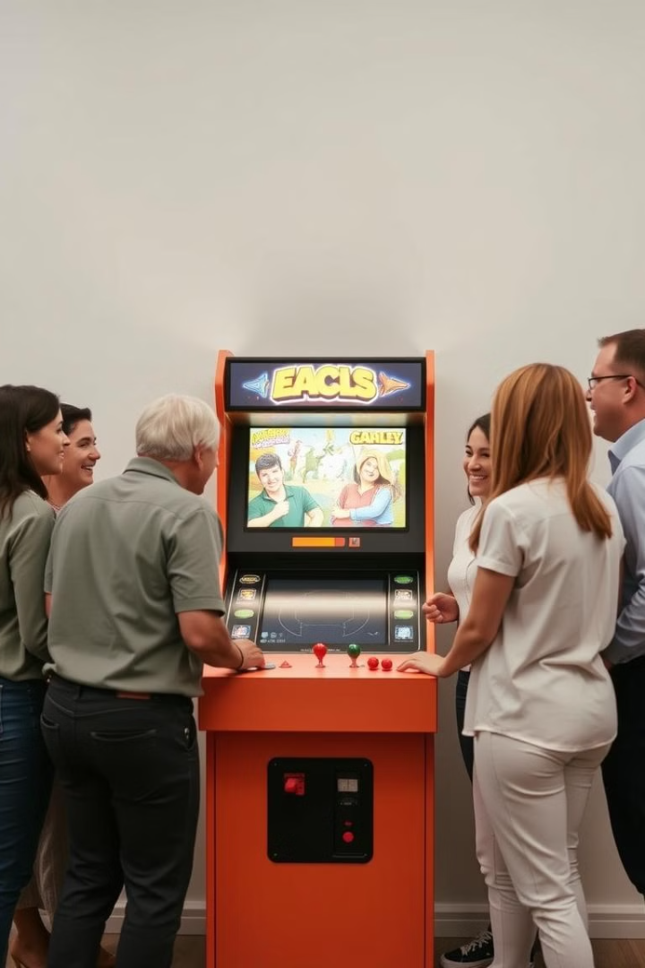
Motivation
1
Nostalgia
2
Accessibility
Reliving the golden age of gaming through a modern platform, providing a nostalgic experience for gamers of all ages.
Making classic games readily available and playable on modern devices, eliminating the need for costly vintage hardware and accessories.
3
Community
4
Educational Value
Fostering a community of retro gaming enthusiasts, providing a platform for sharing knowledge, tips, and game ROMs.
Offering a hands-on learning experience in emulation technology, software development, and the history of video games.

Slide 4
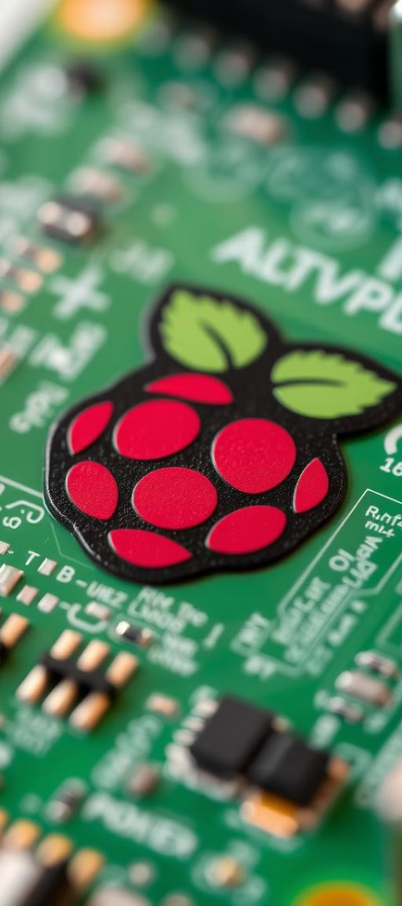
Objective
Create a Retro Gaming Console Using RetroPie
Ensure Seamless Hardware-Software Integration
Build a functional gaming system with integrated joystick and display, capable of emulating classic games.
Properly configure the joystick, buttons, and display for smooth operation, enhancing overall user experience.
Customization
Optimize system performance for responsive gameplay, ensuring stability and minimizing latency.

Slide 5
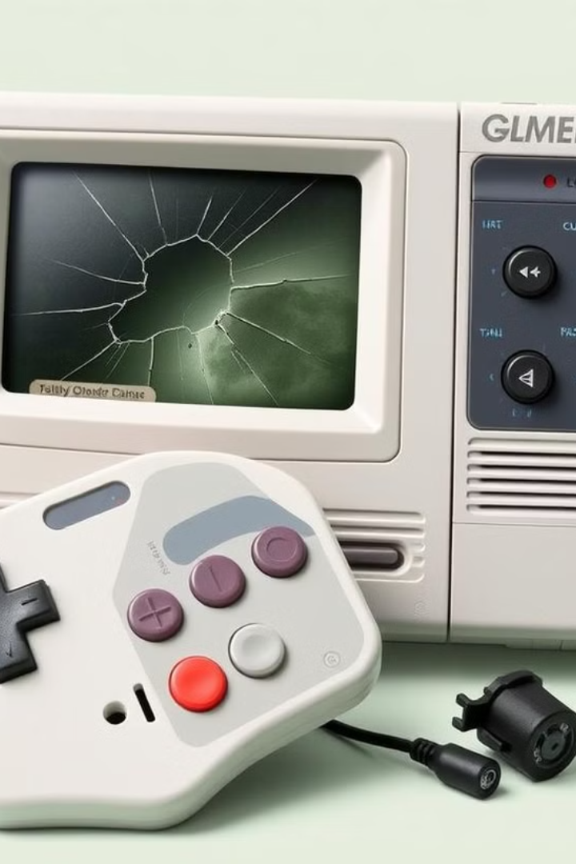
Problem Statement
Limited Access Many classic video games are no longer available on modern platforms, making it difficult for players to access them.
Expensive Hardware Original retro gaming consoles can be expensive and difficult to find in good condition.
Technical Expertise Setting up and configuring retro gaming systems can be challenging for users without technical expertise.

Slide 6
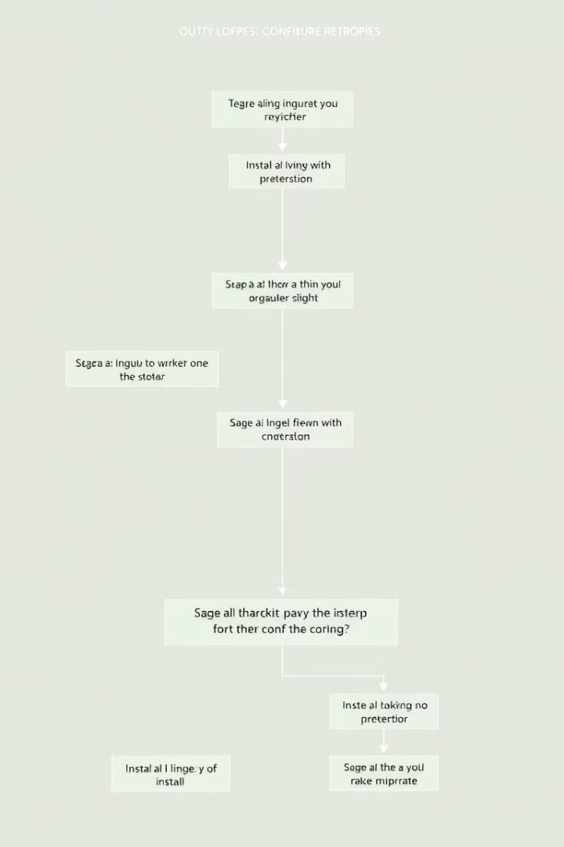
System Model and Workflow
1
Step 1: Installation
RetroPie can be installed from a pre-built image or by manually configuring the Raspberry Pi's operating system.
2
Step 2: Raspberry Pi
Accessing Raspberry Pi's terminal by obtaining IP address and establishing connection through Putty.
3
Step 3: Configuration
Users can customize settings, such as controllers, display resolutions, and emulator options, to suit their preferences.
4
Step 4: Game Loading
ROM files containing the game data are loaded into the system, allowing users to access and play their favorite classic games.
5
Step 5: Emulation
The emulators within RetroPie mimic the hardware and software of different retro consoles, enabling the games to run accurately and smoothly.

Slide 7
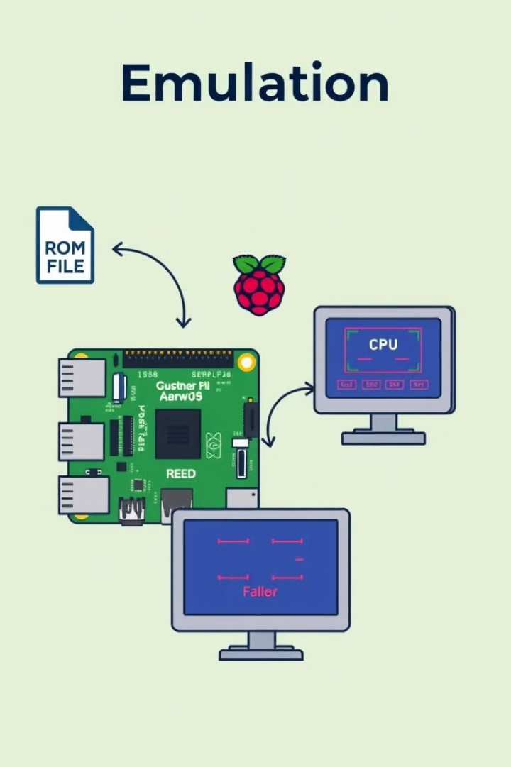




Working Principle
ROM Loading
RetroPie loads game data from ROM files, which contain the instructions and data necessary for the games to run.
Emulation
Emulators within RetroPie interpret the ROM data and mimic the behavior of the original console's hardware and software.
Graphics Rendering
The emulated game's graphics are rendered by the Raspberry Pi, displaying the game's visuals on the screen.
Input Handling
RetroPie translates input signals from controllers into commands understood by the emulated console, allowing users to interact with the game.

Slide 8
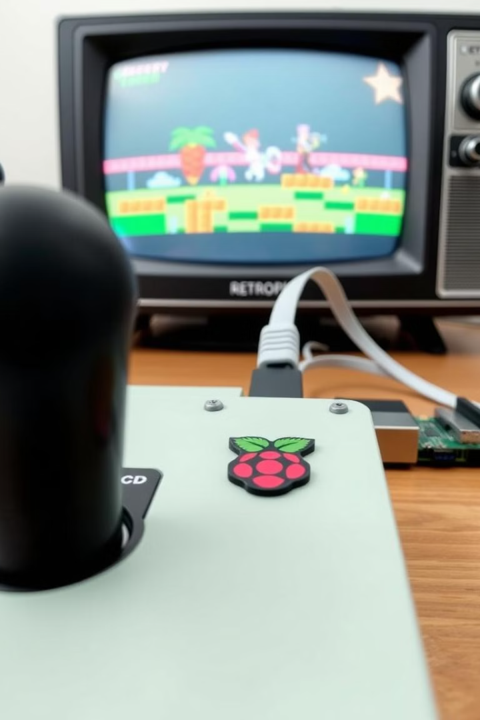
Components Used
Component
Function
Raspberry Pi
The central processing unit, running the operating system and emulators.
Emulators
Software programs that mimic the behavior of different retro consoles.
ROM Files
Digital copies of the original game cartridges or disks, containing the game data.
Joystick
A physical input device that allows users to control the emulated games.
Display
A screen that displays the emulated games' visuals.

Slide 9

DC Fan
Heat sink
12V DC fan, designed for efficient cooling Operates at 0.08 amps.
A passive cooling device used to dissipate heat generated by the Raspberry Pi’s processor.
Provides active airflow to regulate temperature and prevent overheating.
It is typically made of aluminum or copper to efficiently absorb and spread heat across a larger surface area.
Ideal for compact electronic devices like Raspberry Pi or other microcontroller setups.
By reducing the temperature of the CPU, it prevents thermal throttling and ensures the Raspberry Pi operates at optimal performance.
Quiet operation with reliable performance for extended use.

Slide 10
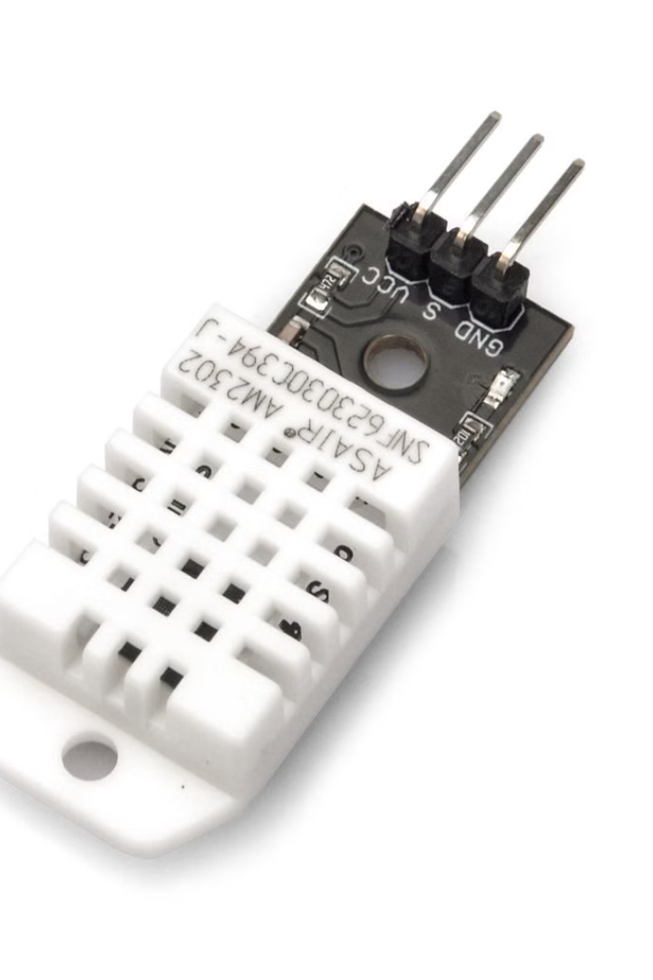
DHT 22
DHT22 Sensor: A digital sensor designed to measure temperature and humidity with high precision.
Working Principle: Uses a thermistor and capacitive humidity sensor to detect temperature and humidity levels.
Key Features: Provides accurate readings, supports a wide temperature range (-40°C to 80°C), and is easy to interface with microcontrollers.
Application in Project: The DHT22 is used to monitor the temperature of the Raspberry Pi processor.
Fan Control Mechanism: Initially, the fan runs at a lower speed. If the DHT22 detects a temperature exceeding 28°C, the fan speed increases to cool the processor.
Advantages: Ensures efficient cooling and prevents overheating, prolonging the life of the processor.
Data Communication: Operates using a single digital pin, simplifying wiring and integration.

Slide 11
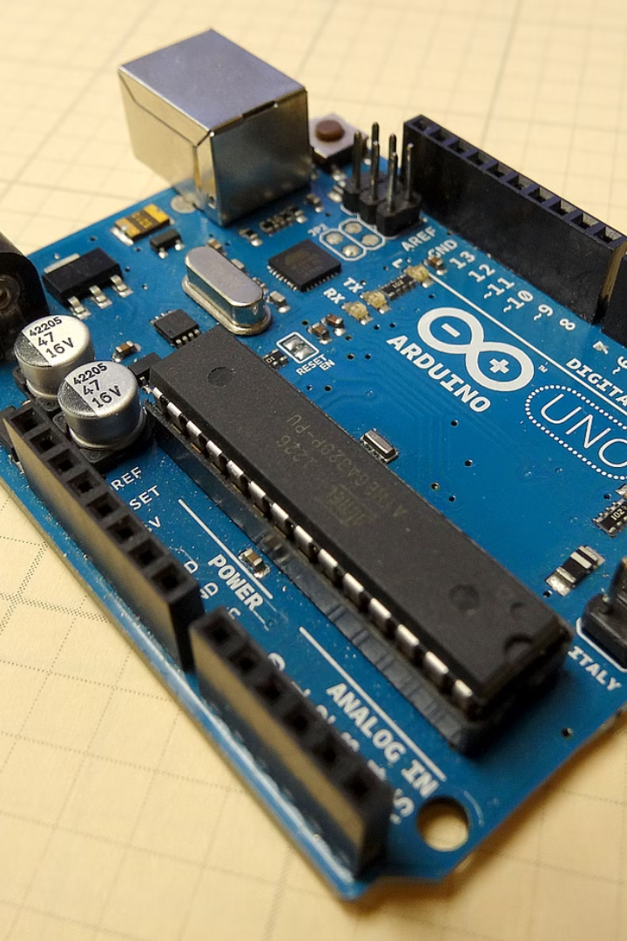
Arduino Uno 4
Introduction: The Arduino Uno is a popular microcontroller board based on the ATmega328P, ideal for beginners and advanced users alike.
Features: It includes 14 digital I/O pins (6 PWM outputs), 6 analog inputs, a 16 MHz quartz crystal, and a USB connection for programming and power.
Versatility: Compatible with various sensors and shields, it is widely used for automation, robotics, and IoT projects.
Ease of Use: Supports the Arduino IDE, making programming simple and accessible for a variety of applications.

Slide 12
Results and Challenges
Results
Challenges
RetroPie has been highly successful in achieving its objective, providing a seamless and enjoyable retro gaming experience for users.
Despite its successes, RetroPie faces certain challenges, which are being actively addressed by the community.
Performance limitations for some games requiring high processing power.
Highly customizable and user-friendly interface.
Extensive support for various retro consoles and games.
Faced challenges in obtaining IP address of Raspberry Pi.
Cost-effective alternative to collecting and maintaining vintage hardware.
Compatibility issues with certain game ROM files or emulators.
Active community of developers and enthusiasts.
Legal concerns surrounding the distribution of game ROM files.

Slide 13
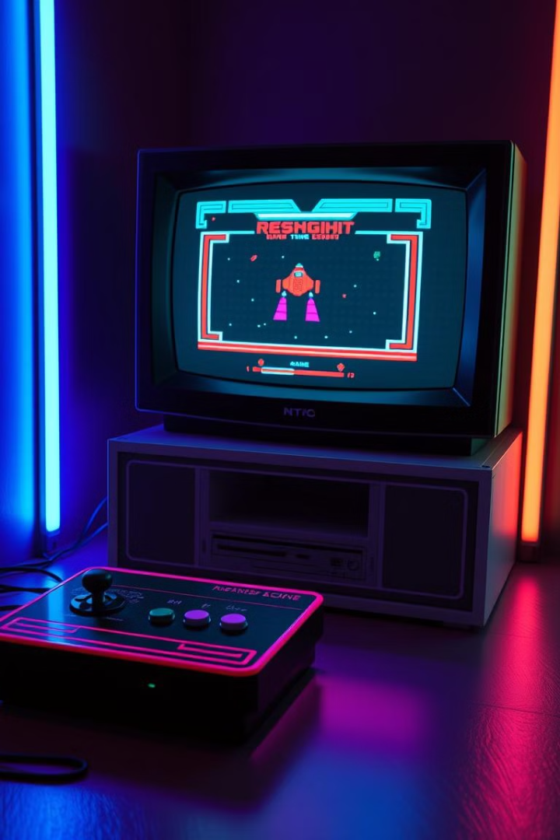
Conclusion
RetroPie has become a remarkable project, successfully bringing retro gaming to life for a modern audience. Its open-source nature, extensive support for various consoles, and ease of use have made it a popular choice for gamers seeking a nostalgic experience. While certain challenges remain, the community continues to improve and expand RetroPie, ensuring its future as a platform for preserving and experiencing the golden age of gaming.

